Slide 1

Basic Electrical Engineering (BEEE101L)
Presented By
Dr. Maddela Chinna Obaiah
Assistant Professor (Sr)
School of Electrical Engineering

Slide 2
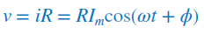
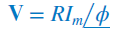

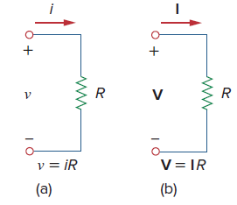
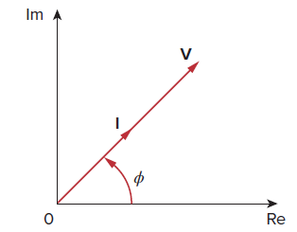
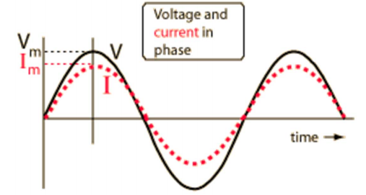
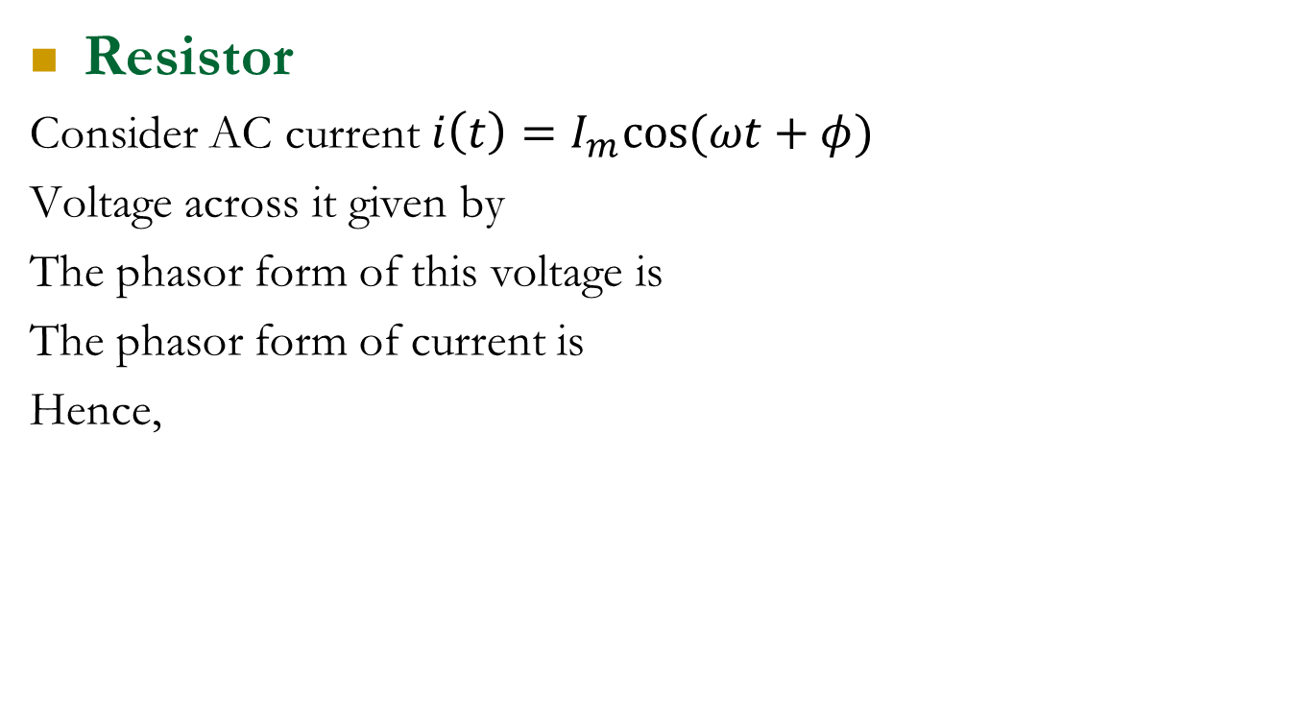
Phasor Relationships for Circuit Elements
Resistor
Consider AC current $i\left(t\right)=I_{m}cos(ωt+φ)$
Voltage across it given by
The phasor form of this voltage is
The phasor form of current is
Hence,
time-domain
Phasor domain
Phasor Diagram
Current and voltage waveforms

Slide 3
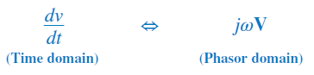
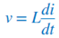
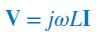
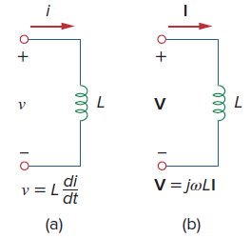
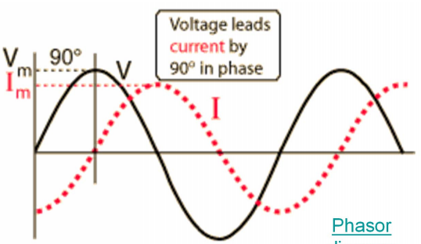
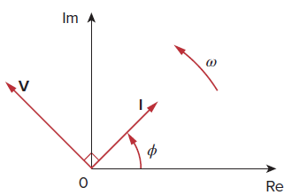
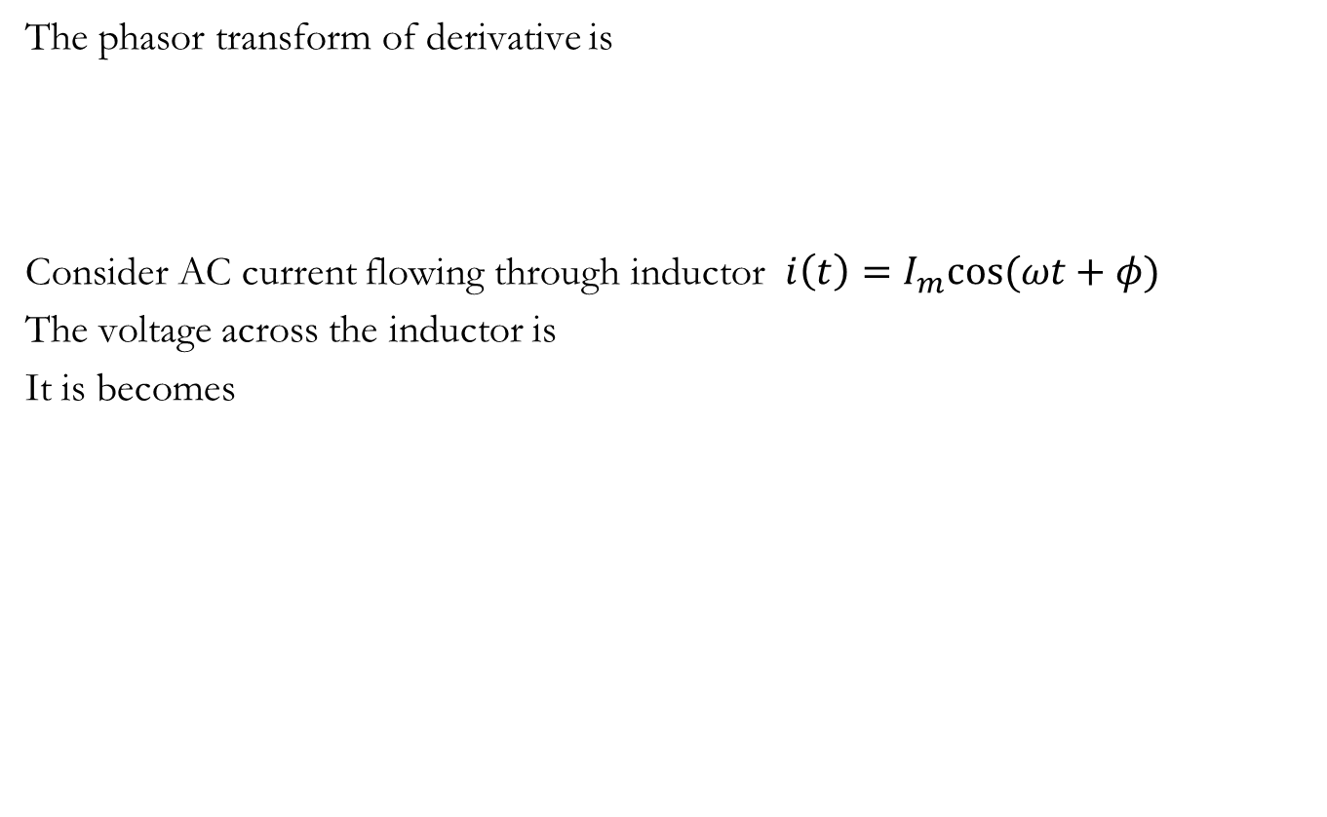
Inductor:
The phasor transform of derivative is
Consider AC current flowing through inductor $i\left(t\right)=I_{m}cos(ωt+φ)$
The voltage across the inductor is
It is becomes

Slide 4
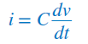
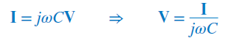
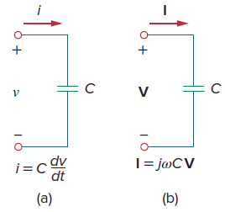
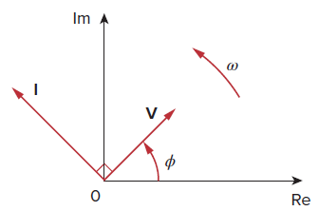
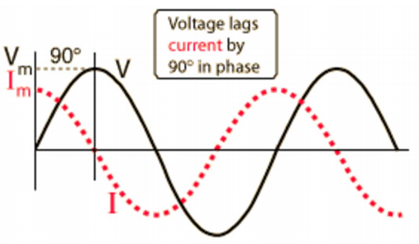
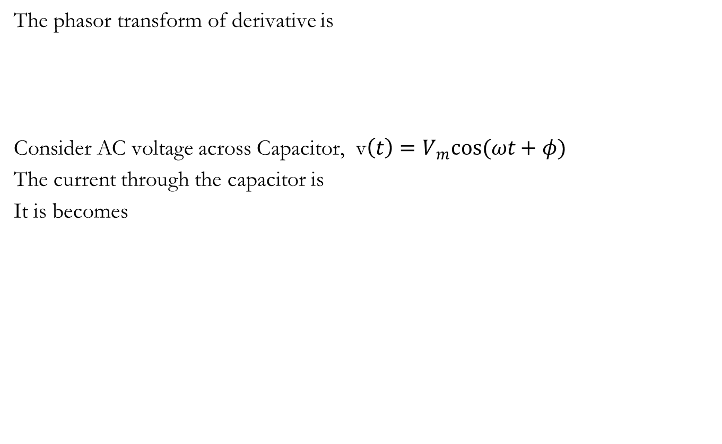
Capacitor:
The phasor transform of derivative is
Consider AC voltage across Capacitor, v$\left(t\right)=V_{m}cos(ωt+φ)$
The current through the capacitor is
It is becomes

Slide 5
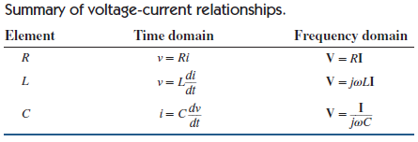
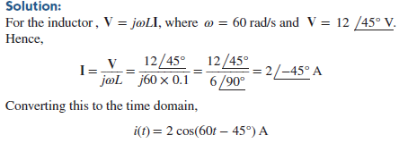
Problem:
Problem:

Slide 6
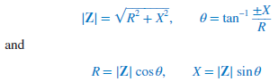
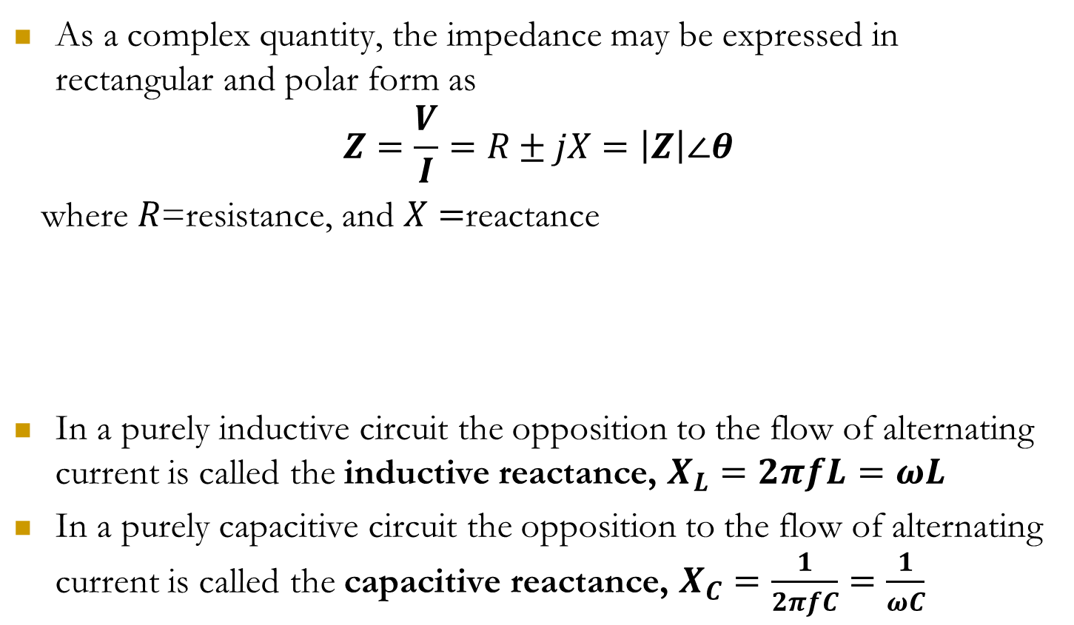
Impedance
As a complex quantity, the impedance may be expressed in rectangular and polar form as
$$Z=\frac{V}{I}=R±jX=\left|Z\right|∠θ$$
where $R$=resistance, and $X=$reactance
In a purely inductive circuit the opposition to the flow of alternating current is called the inductive reactance, $X_{L}=2πfL=ωL$
In a purely capacitive circuit the opposition to the flow of alternating current is called the capacitive reactance, $X_{C}=\frac{1}{2πfC}=\frac{1}{ωC}$

Slide 7
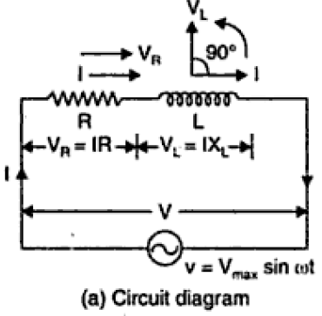
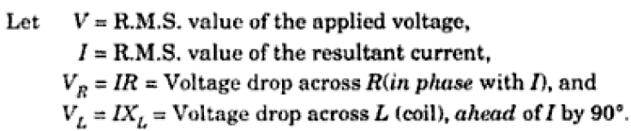
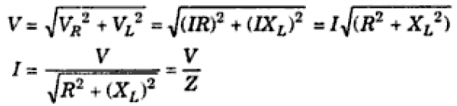
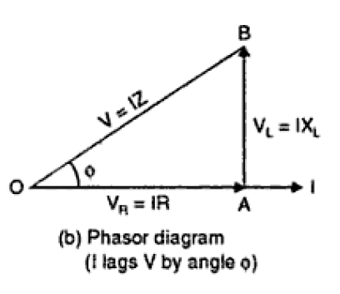
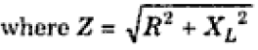
R-L Series Circuit
From Phasor diagram (b)
(total opposition offered to the flow of alternating current by R-L series circuit is known as impedance of the circuit).

Slide 8
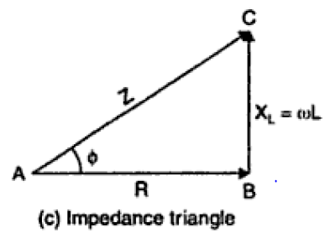
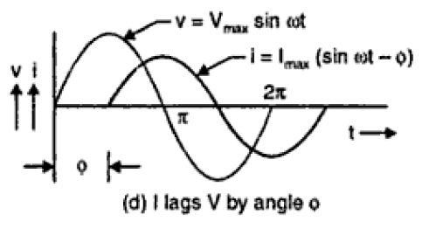
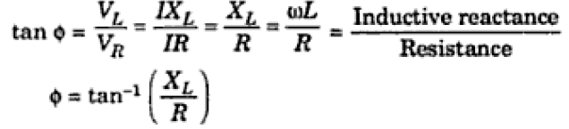
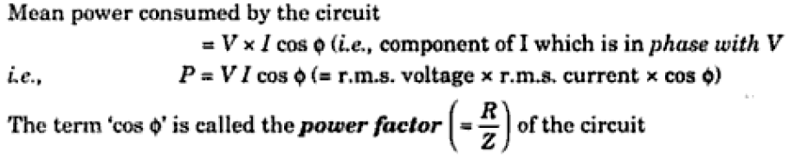

The impedance triangle from phasor diagram (b) is shown in Fig. (c).
From impedance triangle,
From Fig. (d), it is evident that voltage leads the current by an angle $φ$ such that

Slide 9
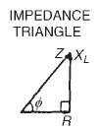
Problem: A coil has a resistance of 4 and an inductance of 9.55mH. Calculate (a) the reactance, (b) the impedance, and (c) the current taken from a 240V, 50Hz supply. Determine also the phase angle between the supply voltage and current.
Solution: Given data
R=4; L =9.55mH=9.55×10⁻³H; f =50Hz; V =240V
Inductive reactance, X_{L} =2πfL =2π(50)(9.55×10⁻³)=3
(b) Impedance, Z =√(R² +X_{L}² )=√(4²+3²)=5
(c) Current, I = V/Z= 240/5=48A
The circuit and phasor diagrams and the voltage and impedance triangles are as shown in Figure.
Since tanφ= X_{L}/R, φ= tan⁻¹ (X_{L}/R) = tan⁻¹ (3/4) = 36.87◦ lagging

Slide 10
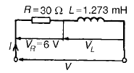
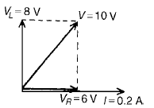
Problem: A pure inductance of 1.273mH is connected in series with a pure resistance of 30. If the frequency of the sinusoidal supply is 5kHz and the p.d. across the 30 resistor is 6V, determine the value of the supply voltage and the voltage across the 1.273mH inductance. Draw the phasor diagram.
Solution: Given data
L=1.273mH, R=30 ohm, V_{R}=6V, f=5kHz
Supply voltage, V =IZ
Current I = V_{R} /R= 6/30=0.20A
Inductive reactance X_{L}=2πfL=2π(5×10³)(1.273×10⁻³)=40
Impedance, Z =√(R² +X_{L}²)=√(30²+40²)=50
Supply voltage V =IZ=(0.20)(50)=10V
Voltage across the 1.273mH inductance, V_{L}=IX_{L}=(0.2)(40)=8V
The phasor diagram is shown in Figure.
Fig. Phasor diagram

Slide 11
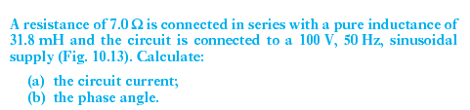
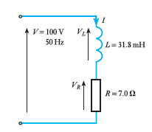
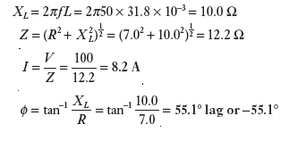
Problem
Solution

Slide 12
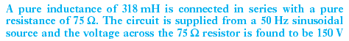
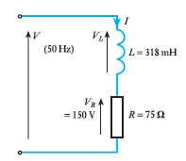
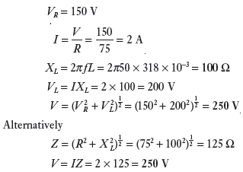
Problem
Solution

Slide 13
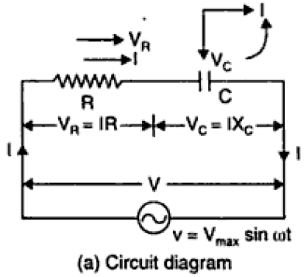
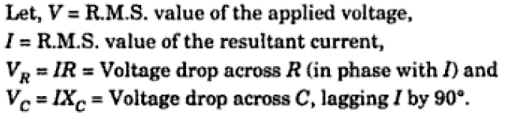
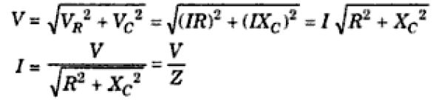
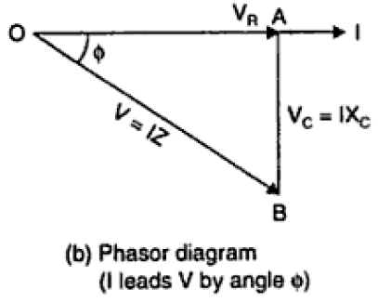
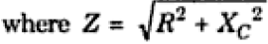
R-C Series Circuit
From Phasor diagram (b)
(total opposition offered to the flow of alternating current by R-C series circuit is known as impedance of the circuit).

Slide 14
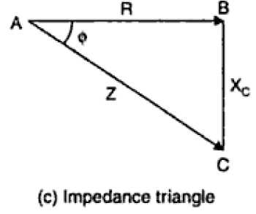
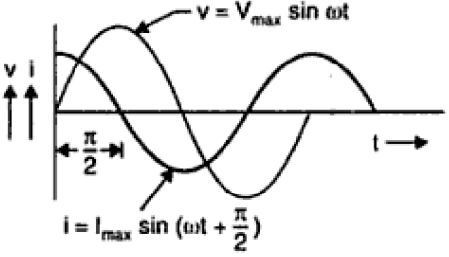
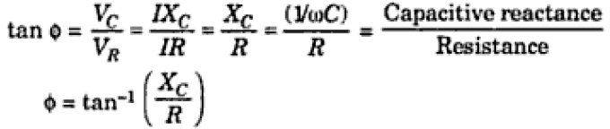
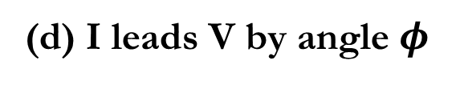

The impedance triangle from phasor diagram (b) is shown in Fig. (c).
From impedance triangle,
From Fig. (d), it is evident that voltage leads the current by an angle $φ$ such that
(d) I leads V by angle $φ$

Slide 15

Problem: A resistor of 25 is connected in series with a capacitor of 45μF. Calculate (a) the impedance, and (b) the current taken from a 240V, 50Hz supply. Find also the phase angle between the supply voltage and the current.
Solution: Given date
R=25; C = 45μF = 45×10⁻⁶ F; V =240V; f =50Hz
Capacitive reactance, X_{C} = 12πfC= 12π(50)(45×10⁻⁶)= 70.74
(a) Impedance Z =√(R² +X_{C}²)=√[(25)²+(70.74)²]=75.03
(b) Current I = V/Z= 240/75.03=3.20A
Phase angle between the supply voltage and current from impedance triangle,
α= tan⁻¹(X_{C}/R)
hence α= tan⁻¹(70.7425)=70.54◦ leading

Slide 16



Problem
Solution

Slide 17




R-L-C Series Circuit

Slide 18



When X_{L}=X_{C} (from (d)), the applied voltage V and the current I are in phase. This effect is called series resonance

Slide 19





Problem
Solution

Slide 20


Ans: Current I = 5.15 A, phase difference $φ={52}^{°}$ (lagging), Power consumed =371.1 W.
Problem: A 40μF capacitor in series with a coil of resistance 8 ohm and inductance 80mH is connected to a 200V, 100Hz supply. Calculate (a) the circuit impedance, (b) the current flowing, (c) the phase angle between voltage and current, (d) the voltage across the coil, and (e) the voltage across the capacitor.
Ans: (a) 13.18 (b) 15.17A (c) 52.63◦ lagging (d) 772.1V (e) 603.6V

Slide 21



Resonance in RLC circuits

Slide 22



Slide 23



